Slide 1


John Mark Alexis Marcelo 185018
Multi-ConDos
VISIOPE PROJECT

Slide 2
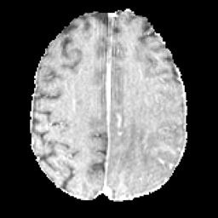

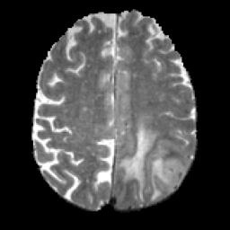
ORIGINAL PAPER
The main goal of the paper is to develop a
self-supervised method for the automatic segmentation of brain tumors from multimodal medical images, such as MRI scans in T1, T2, FLAIR, and T1ce modalities.

Slide 3
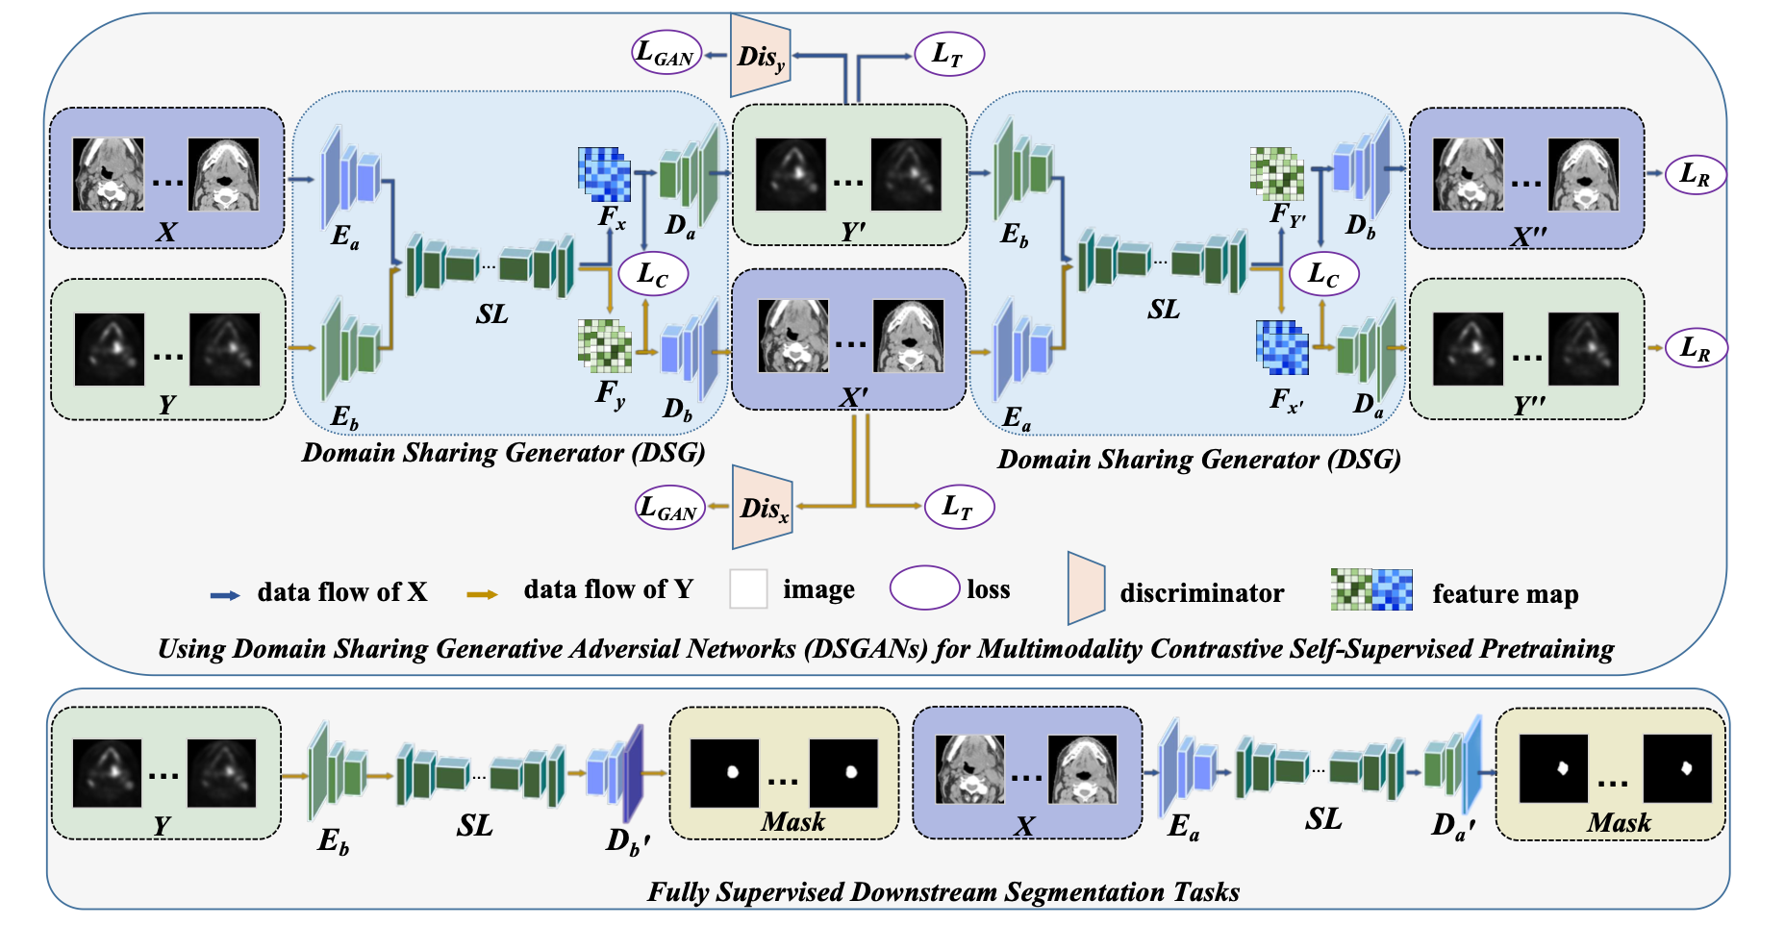
ORIGINAL ARCHITECTURE

Slide 4
ORIGINAL ARCHITECTURE
DSGAN

Slide 5
ORIGINAL ARCHITECTURE
SHARING LAYERS

Slide 6
ORIGINAL ARCHITECTURE
MULTICON DOS

Slide 7


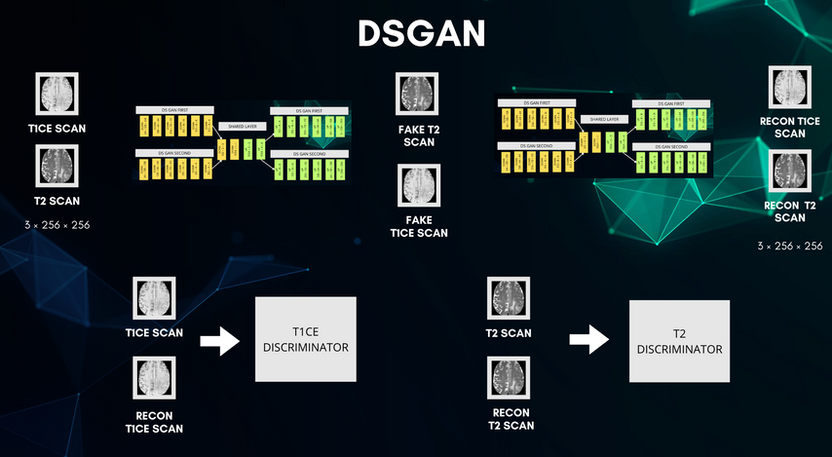
MY WORK

Slide 8
MY WORK
Reimplementation on lightning on MacOs Env
Reform the architecture

Slide 9
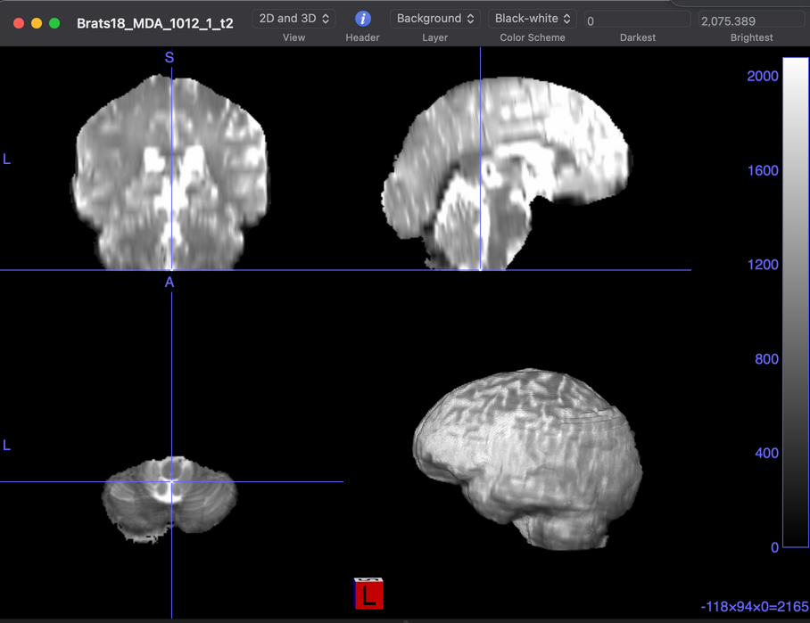
MICCAI DATASET
Preprocess via
SimpleITK module

Slide 10
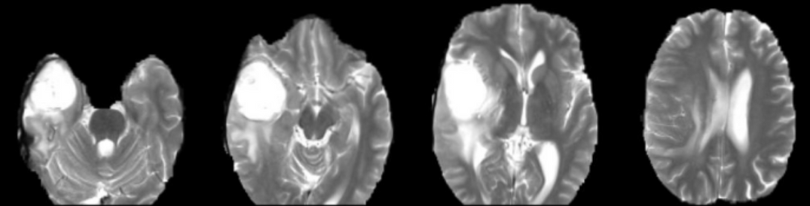
MICCAI DATASET
Preprocess via
SimpleITK module
3D to .jpg files
(256 x 256px)
144 images for each 3d Brain

Slide 11


DSGAN GENERATOR
DS GAN FIRST
DS GAN FIRST
T1CE SCAN
SHARED LAYER
FAKE T2 SCAN
DS GAN SECOND
DS GAN SECOND
T2 SCAN
3 × 256 × 256
FAKE
T1CE SCAN

Slide 12
DSGAN GENERATOR
DS GAN FIRST
DS GAN FIRST
DOWN
64 × 128 × 128
DOWN
128 × 64 × 64
DOWN
256 × 32 × 32
DOWN
512 × 16 × 16
DOWN
512 × 8 × 8
DOWN
512 × 4 × 4
UP
512 × 8 × 8
UP
512 × 16 × 16
UP
256 × 32 × 32
UP
128 × 64 × 64
UP
64 × 128 × 128
UP
3 × 256 × 256
T1CE SCAN
SHARED LAYER
FAKE T2 SCAN
DS GAN SECOND
DOWN
512 × 2 × 2
DOWN
1024 × 1 × 1
UP
1024 × 2 × 2
UP
1024 × 4 × 4
DS GAN SECOND
T2 SCAN
3 × 256 × 256
DOWN
64 × 128 × 128
DOWN
128 × 64 × 64
DOWN
256 × 32 × 32
DOWN
512 × 16 × 16
DOWN
512 × 8 × 8
DOWN
512 × 4 × 4
UP
512 × 8 × 8
UP
512 × 16 × 16
UP
256 × 32 × 32
UP
128 × 64 × 64
UP
64 × 128 × 128
UP
3 × 256 × 256
FAKE
T1CE SCAN

Slide 13
DSGAN GENERATOR
DS GAN FIRST
DS GAN FIRST
DOWN
64 × 128 × 128
DOWN
128 × 64 × 64
DOWN
256 × 32 × 32
DOWN
512 × 16 × 16
DOWN
512 × 8 × 8
DOWN
512 × 4 × 4
UP
512 × 8 × 8
UP
512 × 16 × 16
UP
256 × 32 × 32
UP
128 × 64 × 64
UP
64 × 128 × 128
UP
3 × 256 × 256
SHARED LAYER
T1CE SCAN
SHARED LAYER
FAKE T2 SCAN
DS GAN SECOND
DOWN
1024 × 1 × 1
UP
1024 × 2 × 2
UP
1024 × 4 × 4
DS GAN SECOND
DOWN
512 × 2 × 2
DOWN
1024 × 1 × 1
UP
1024 × 2 × 2
UP
1024 × 4 × 4
DOWN
512 × 2 × 2
T2 SCAN
3 × 256 × 256
DOWN
64 × 128 × 128
DOWN
128 × 64 × 64
DOWN
256 × 32 × 32
DOWN
512 × 16 × 16
DOWN
512 × 8 × 8
DOWN
512 × 4 × 4
UP
512 × 8 × 8
UP
512 × 16 × 16
UP
256 × 32 × 32
UP
128 × 64 × 64
UP
64 × 128 × 128
UP
3 × 256 × 256
FAKE
T1CE SCAN

Slide 14

DSGAN GENERATOR
DS GAN FIRST
DS GAN FIRST
DOWN
128 × 64 × 64
DOWN
256 × 32 × 32
DOWN
512 × 16 × 16
DOWN
512 × 8 × 8
DOWN
512 × 4 × 4
UP
512 × 8 × 8
UP
512 × 16 × 16
UP
256 × 32 × 32
UP
128 × 64 × 64
UP
64 × 128 × 128
UP
3 × 256 × 256
DOWN
UP
DOWN
64 × 128 × 128
SHARED LAYER
T1CE SCAN
SHARED LAYER
FAKE T2 SCAN
CONV 2D
CONV
TRASPOSE 2D
DS GAN SECOND
DOWN
1024 × 1 × 1
UP
1024 × 2 × 2
UP
1024 × 4 × 4
DS GAN SECOND
DOWN
512 × 2 × 2
DOWN
1024 × 1 × 1
UP
1024 × 2 × 2
UP
1024 × 4 × 4
DOWN
512 × 2 × 2
T2 SCAN
INSTANCE NORMALIZATION 2D
INSTANCE NORMALIZATION 2D
3 × 256 × 256
DOWN
64 × 128 × 128
DOWN
128 × 64 × 64
DOWN
256 × 32 × 32
DOWN
512 × 16 × 16
DOWN
512 × 8 × 8
DOWN
512 × 4 × 4
UP
512 × 8 × 8
UP
512 × 16 × 16
UP
256 × 32 × 32
UP
128 × 64 × 64
UP
64 × 128 × 128
UP
3 × 256 × 256
FAKE
T1CE SCAN
LEAKY RELU
RELU

Slide 15
DSGAN GENERATOR
DS GAN FIRST
DS GAN FIRST
DOWN
128 × 64 × 64
DOWN
256 × 32 × 32
DOWN
512 × 16 × 16
DOWN
512 × 8 × 8
DOWN
512 × 4 × 4
UP
512 × 8 × 8
UP
512 × 16 × 16
UP
256 × 32 × 32
UP
128 × 64 × 64
UP
64 × 128 × 128
UP
3 × 256 × 256
DOWN
UP
DOWN
64 × 128 × 128
SHARED LAYER
T1CE SCAN
SHARED LAYER
FAKE T2 SCAN
CONV 2D
CONV
TRASPOSE 2D
DS GAN SECOND
DOWN
1024 × 1 × 1
UP
1024 × 2 × 2
UP
1024 × 4 × 4
DS GAN SECOND
DOWN
512 × 2 × 2
DOWN
1024 × 1 × 1
UP
1024 × 2 × 2
UP
1024 × 4 × 4
DOWN
512 × 2 × 2
T2 SCAN
INSTANCE NORMALIZATION 2D
INSTANCE NORMALIZATION 2D
3 × 256 × 256
DOWN
64 × 128 × 128
DOWN
128 × 64 × 64
DOWN
256 × 32 × 32
DOWN
512 × 16 × 16
DOWN
512 × 8 × 8
DOWN
512 × 4 × 4
UP
512 × 8 × 8
UP
512 × 16 × 16
UP
256 × 32 × 32
UP
128 × 64 × 64
UP
64 × 128 × 128
UP
3 × 256 × 256
FAKE
T1CE SCAN
LEAKY RELU
RELU

Slide 16
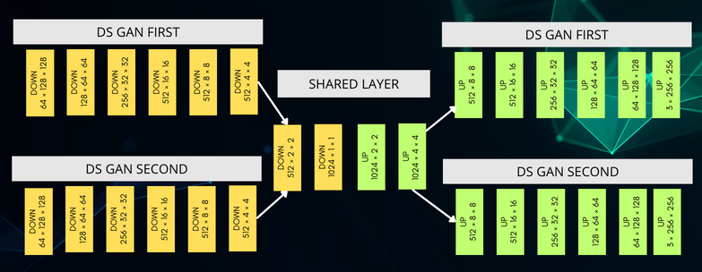
DSGAN
T1CE SCAN
FAKE T2 SCAN
T2 SCAN
FAKE
T1CE SCAN

Slide 17
DSGAN
T1CE SCAN
FAKE T2 SCAN
RECON T1CE
SCAN
T2 SCAN
RECON T2
SCAN
FAKE
T1CE SCAN

Slide 18
DSGAN
T1CE SCAN
FAKE T2 SCAN
RECON T1CE
SCAN
T2 SCAN
RECON T2
SCAN
FAKE
T1CE SCAN
T1CE SCAN
IDENTITY T1CE
T2 SCAN
IDENTITY RECON T2

Slide 19
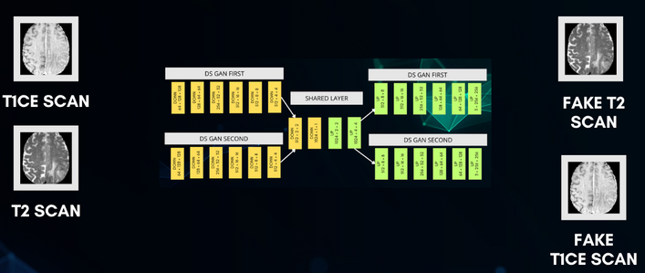
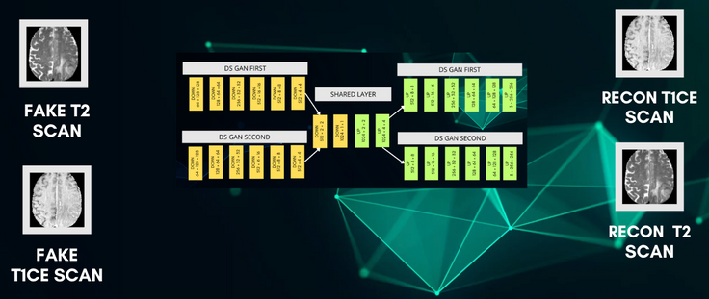
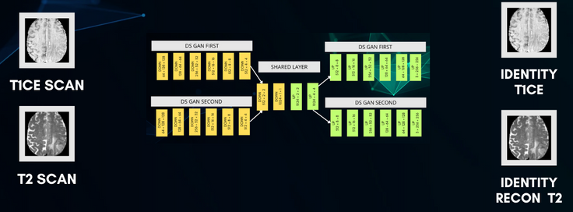
DSGAN LOSSES

Slide 20
DSGAN LOSSES
DISCRIMINATOR
DOWN
64X128X128
DOWN
128X64X64
DOWN
256X32X32
DOWN
512X31X31
CONV2D
1X30X30

Slide 21
DSGAN LOSSES
DISCRIMINATOR LOSS
ADVERSARIAL LOSS
DISCRIMINATOR
DOWN
64X128X128
DOWN
128X64X64
DOWN
256X32X32
DOWN
512X31X31
CONV2D
1X30X30

Slide 22
DSGAN LOSSES
DISCRIMINATOR LOSS
ADVERSARIAL LOSS
DISCRIMINATOR
CYCLE LOSS
DOWN
64X128X128
DOWN
128X64X64
DOWN
256X32X32
DOWN
512X31X31
CONV2D
1X30X30

Slide 23
DSGAN LOSSES
DISCRIMINATOR LOSS
ADVERSARIAL LOSS
DISCRIMINATOR
CYCLE LOSS
DOWN
64X128X128
DOWN
128X64X64
DOWN
256X32X32
DOWN
512X31X31
CONV2D
1X30X30
IDENTITY LOSS

Slide 24
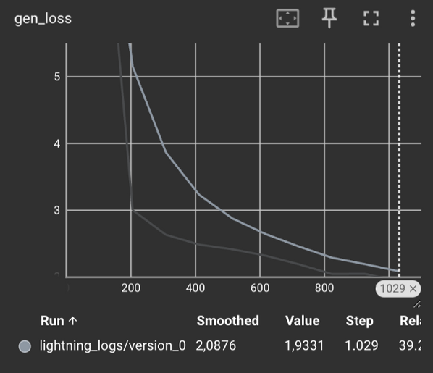
DSGAN RESULTS
CYCLE + ADVERSARIAL + IDENTITY LOSS

Slide 25
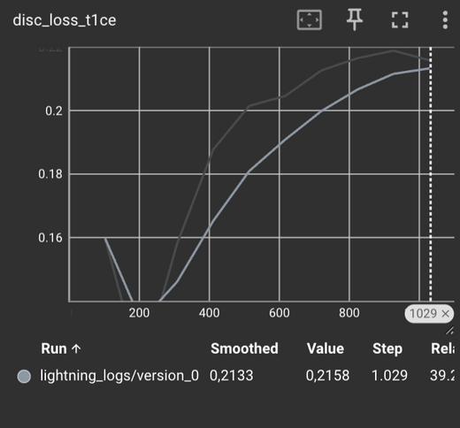
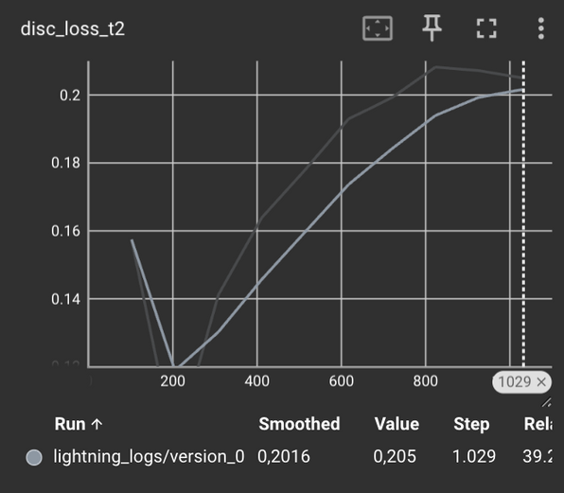
DSGAN RESULTS
CYCLE + ADVERSARIAL + IDENTITY LOSS
( T1CE REAL LOSS + FAKE LOSS) / 2
( T1CE REAL LOSS + FAKE LOSS) / 2

Slide 26
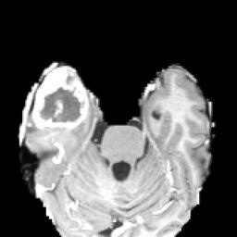

FINE TUNING PHASE
NEW INPUT
T1CE SCAN
MASK
3 × 256 × 256

Slide 27
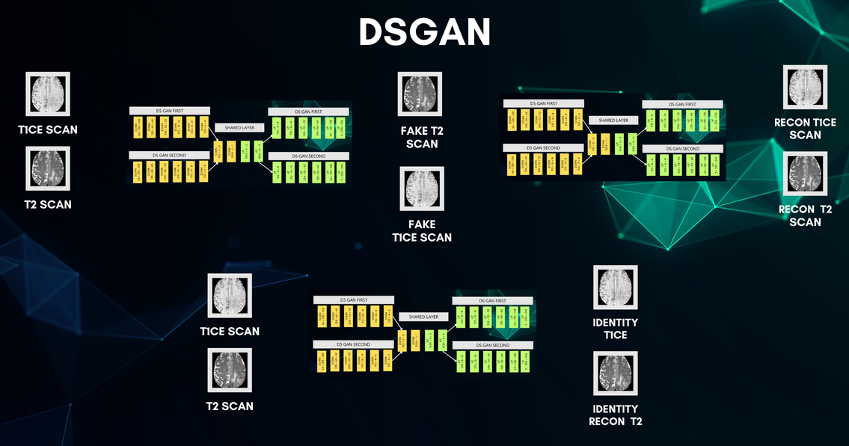
FINE TUNING PHASE
PRE-TRAINED
NEW INPUT
T1CE SCAN
MASK
3 × 256 × 256

Slide 28
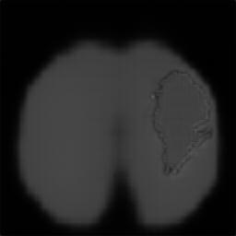
FINE TUNING PHASE
PRE-TRAINED
NEW INPUT
OUTPUT
T1CE SCAN
MASK
3 × 256 × 256

Slide 29
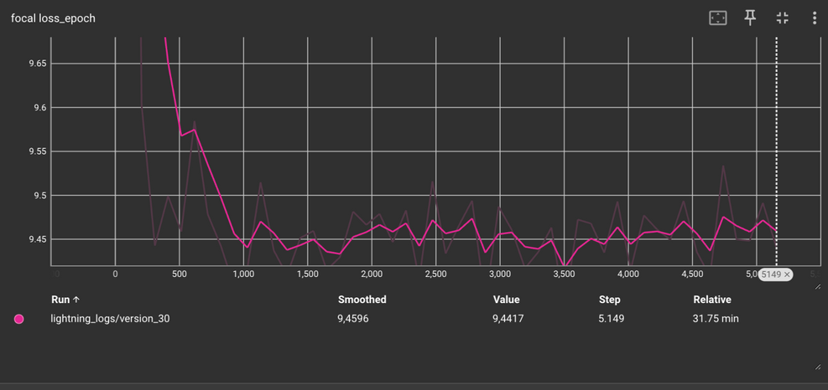
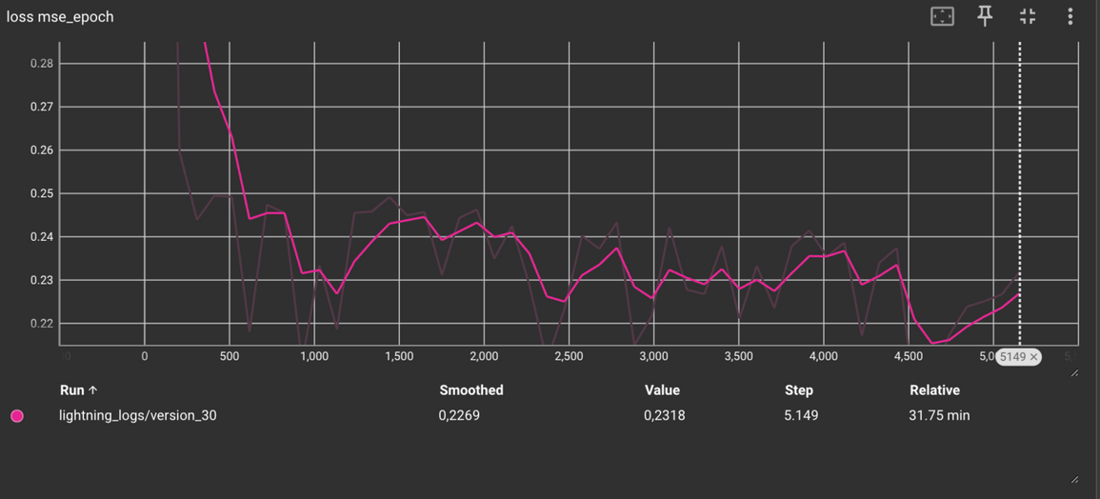
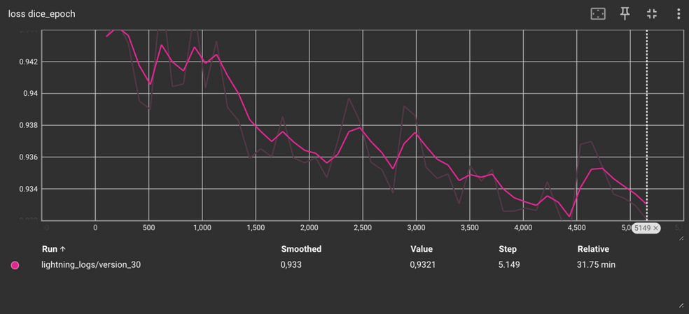
LOSSES
FOCAL LOSS
MEAN SQUARED ERROR
DICE LOSS

Slide 30
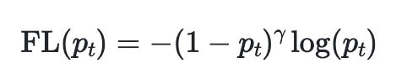
LOSSES
FOCAL LOSS
MEAN SQUARED ERROR
ESTENSION OF BINARY CROSS ENTROPY
PENALIZE EASY SAMPLES
(BLACK IMAGES)
DICE LOSS
IMBALANCED DATASET

Slide 31
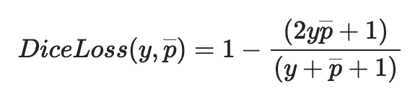
LOSSES
FOCAL LOSS
MEAN SQUARED ERROR
IT USED SEGMENTATION TASKS
PENALIZES MISSING REGIONS
(FALSE NEGATIVE)
DICE LOSS

Slide 32
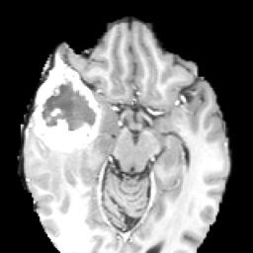
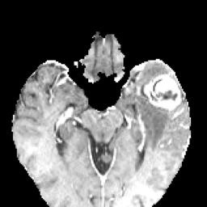
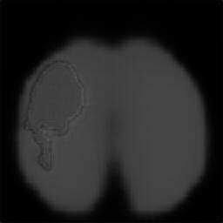
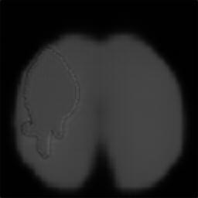
RESULTS
T1CE SCAN
MASK GENERATED

Slide 33

RESULTS
T1CE SCAN
MASK GENERATED

Slide 34
THANK YOU!
FOR YOUR ATTENTION

